Slide 1
Healthcare AI: A Quebec Framework for Nursing Education
Introduction to the Competency Framework
Laura Winer (PI) – Maggie Lattuca – Diane Maratta – Joanna Kamar Teaching and Learning Services, McGill University
Annie Chevrier Ingram School of Nursing, McGill University
Ute Beffert (PI) John Abbott College
Notes:
Laura

Slide 2
Today’s Agenda
Project team
Mandate
Method and timeline
Validation of the Competency Framework
Questions, feedback
Notes:
Laura

Slide 3
Project Team
Principal Investigators:
Dr. Laura Winer, Director, Teaching and Learning Services, McGill University
Ute Beffert, RN, BScN M.Ed., Nursing instructor, John Abbott College
Co-Investigators:
Annie Chevrier, Program Director, BN (I) and Online Education Initiatives and Continuing Nursing Education, Ingram School of Nursing.
Maggie Lattuca, Manager, Online Programs Portfolio, Teaching and Learning Services
Diane Maratta, Online Course Designer, Teaching and Learning Services
Research Assistants:
Joanna Kamar, Research Assistant, Teaching and Learning Services (2021)
Maripier Bélisle, Research Assistant, Teaching and Learning Services (2020)
Notes:
Laura

Slide 4
Mandate
Artificial Intelligence (AI) technologies continue to expand exponentially in all sectors of our lives. Within the profession of nursing AI tools will have a significant impact on how nurses provide patient care. This project examines the ethical, social, and legal challenges of integrating AI in the practice of nursing. The goal of this project is to develop and validate a competency framework of AI competencies to be recommended for integration in nursing curricula at the CEGEP and university levels.
Objectives:
Understand how AI tools can be used within nursing practice;
Understand the inherent educational, ethical and social implications;
Identify and formulate new competencies for nursing education at the CEGEP and University levels;
Make recommendation to the McGill Anglophone CEGEPs Consortium (MACC*).
*MACC is a partnership between McGill University and 5 Anglophone CEGEPs in Quebec, Dawson College, Heritage College, John Abbott College, and Vanier College.
Notes:
Laura

Slide 5
Method and timeline
Phase 1 (Feb - Aug 2020)
Phase 3 (May – June 2021)
Phase 5 (Jan 2022 – Ongoing)
Literature review L’intelligence artificielle: un aperçu Québécois sur l’éducation des sciences infermières
Development of a preliminary competency framework
Dissemination – MACC, CASN, Publication
Research – Expert interviews, workshops, conferences
Validation of the competency framework (end of project as per PIA)
Phase 2 (Sept 2020 – Aug 2021)
Phase 4 (June 2021 – Ongoing)
Notes:
Maggie
To achieve our goals we went/are going through 4 phases
Phase 1: Literature review provided a broad analysis of the literature – it highlighted the need to prepare student nurses for the integration of AI at multiple levels (introductory/advanced).
Phase 2: Research – included speaking with experts in the field and attending AI events. The challenge was finding the right people to interview. Lack of interest in developing competencies in education for those highly specialized in AI. We did gather solid information from a presentation from Dr. Devin Hopkins (JGH) and Eric Maillet from U of Sherbrooke. We speak more to this research & validation a little later in the presentation.
Phase 3: Development of competency framework: Based on the literature review and team research we developed a competency framework, which Ute will speak to in the next slides.
Phase 4: Validation: We are currently in Phase 4 – validating the competency framework with experts in AI and healthcare.
Post-project: We will present the project to MACC.

Slide 6
Research – Associations
The following associations have influenced and guided our research:
AEESICQ (Association des enseignantes et enseignants en soins infirmiers des collèges du Québec) AQIISTI (Association québécoise des infirmières et infirmiers en systèmes et technologies de l’information) Canada Health Infoway (Adoption of digital health solutions across Canada) CASN (Canadian Association of Schools of Nursing) CNIA (Canadian Nursing Informatics Association) PIA (Le Pôle montréalais d’enseignement supérieur en intelligence artificielle)
WHO (World Health Organization; Health Ethics & Governance Team)
Notes:
Maggie
Numerous Canadian associations already have research into Nursing Informatics and potential needs in the Nursing education competencies. We took into consideration the previously suggested/published views on this issue.

Slide 7
Validation – Expert input
Alain Biron Associate Director of Nursing, Nursing Directorate (Professional Practice, Education & Research) MUHC; Assistant Professor at the Ingram School of Nursing, McGill University
Chantal Bastien Assistant to the Director of Nursing, CIUSSS du Centre-Ouest-de-I'Ile-de-Montreal
Eric Maillet Assistant Professor and Director of Health Informatics Programs, University of Sherbrooke; President AQIISTI(Association québécoise des infirmières et infirmiers en systèmes et technologies de l’information)
Melanie Sheridan ED Clinical Nurse Specialist, Jewish General Hospital
Seth Davis Emergency Medicine Resident, McGill University
John Abbott Nursing Teaching Faculty, John Abbott College Department of Nursing
Notes:
After final validation of these competencies with the partners in the healthcare sector, the goal is to educate future nurses on the benefits and challenges associated with AI care.

Slide 8
Research – Events
August 2020
AI4 2020 Healthcare Track: Exploring Artificial Intelligence in Healthcare
October 2020
Keeping Up With Artificial Intelligence – AI Ethics & Bias - McGill Library Webinar
January 2021
Lancement de la plateforme de cartographie dynamique de l'intelligence artificielle (IA) en éducation
April 2021
Chief Nursing Information Officer (CNIO) Views from Across Canada: A Panel Presentation
Interactive Online Training by AQIISTI / ORIIM/L
Symposium AI Enabled Care: Building Collaboration for Deeper Learning and Better Care
Medical Grand Rounds
June 2021
AEESICQ: June 2021 IT Session
AQIISTI: June 2021 Annual Conference
Notes:
The events that were attended elucidated a common view in that nurses are central to health care teams, as they are key in communicating and coordinating patient care.
•AEESICQ: (Association des enseignantes et enseignants en soins infirmiers des collèges du Québec):

Slide 9
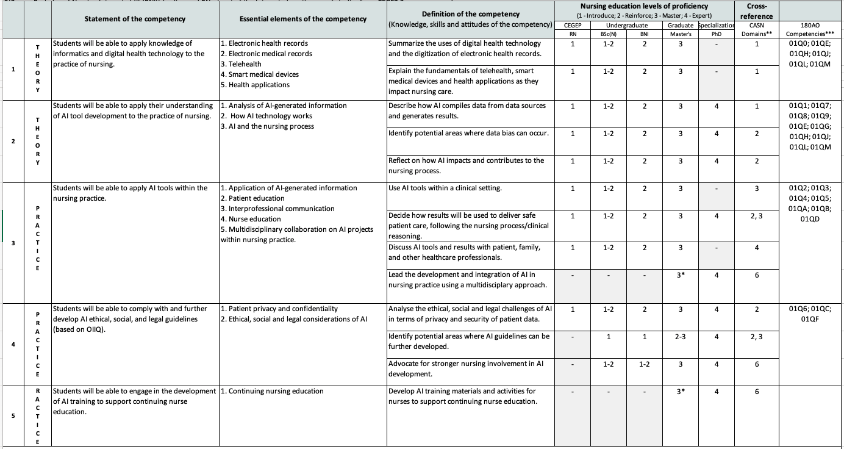
Notes:
Maggie

Slide 10
Validation questions
Are the competency statements clear?
Can you identify any gaps?
Is there a potential relevance of the framework in other healthcare professions?
Notes:
Ute

Slide 11
Notes:
Ute

Slide 12
Notes:
Ute

Slide 13
Validation questions
Are the competency statements clear?
Can you identify any gaps?
Is there a potential relevance of the framework in other healthcare professions?
Notes:
Ute

Slide 14
Selected Resources
The following selected resources were consulted during our research:
Canadian Association of Schools of Nursing/Association canadienne des écoles de sciences infirmières. (2012). Nursing informatics entry-to-practice competencies for registered nurses. https://www.casn.ca/wp-content/uploads/2014/12/Nursing-Informatics-Entry-to-Practice-Competencies-for-RNs_updated-June-4-2015.pdf.
Ethics and governance of artificial intelligence for health: WHO guidance. Geneva: World Health Organization; 2021. Licence: CC BY-NC-SA 3.0 IGO.
Montréal Declaration Responsible AI. (2018). Montréal Declaration for a Responsible Development of Artificial Intelligence. https://www.montrealdeclaration-responsibleai.com/the-declaration.
Yoder-Wise, Patricia S., and Lyle G. Grant. Leading and Managing in Canadian Nursing, Elsevier, 2014.

Slide 15
Thank You!

